Slide 1
Chapter 9
Trust and Reputation in Multiagent Systems

Slide 2











1 -­‐ Introduction
From a local perspective, they are integrated into an agent decision process when it involves other agents in order to decide with whom to interact.
From a global perspective, they can be used as social control mechanisms
Social control mechanisms
Trust and reputation
SoU security
Computational security

Slide 3
2 -­‐ Computational representation of trust and reputation values

Slide 4





Exist many diﬀerent ways to represent trust and reputation values
2 -­‐ Computational representation of trust and reputation values
Simplicity
Expressiveness
Facilitates the calculation functions and the reasoning mechanisms.
Less information, the kind of reasoning that can be done is less sophisticate.
Allows elaborated reasoning mechanisms and sophisticated models.
More computational and storage capacity as well as complex reasoning algorithms.

Slide 5
2 -­‐ Computational representation of trust and reputation values
Boolean
True -­‐> the trustee is trustworthy
False -­‐> the trustee is untrustworthy
Not very useful because Trust (like reputation) is a notion eminently graded and therefore it is important to be able to express how much do you trust.
Numerical values
Real or integer values in a range. (ex. [-­‐1.0,1.0], [0,3000])
Examples:
the trust in an agent X is 0.4 the reputation of agent Y is -­‐1
The most used representation by far.

Slide 6
2 -­‐ Computational representation of trust and reputation values
Qualitative labels
Finite sets of labels in an ordered set.
Examples:
{very_bad, bad, neutral, good, very_good}
Is a trust of 0.6 really diﬀerent from a trust of 0.7 in terms of taking trust decisions?
These sets are mapped to integer numbers so in fact it is a way of reducing the number of output values to simplify the decision making process.
The loss of a ﬁne grain comparison of trust and reputation values is compensated by a universally recognized semantics

Slide 7
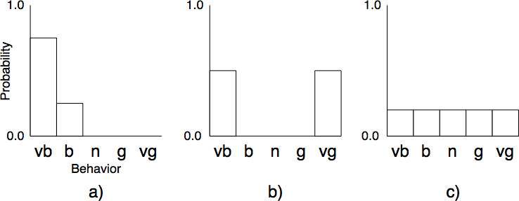
2 -­‐ Computational representation of trust and reputation values
Probability distribution
Discrete probability distribution over a sorted discrete set.
Examples:
With a probability of 0.75 the behaviour of the agent will be very bad, with a probability of 0.25 it will be bad.
Bipolar agent, very bad or very good, never in the middle.
Unpredictable agent.

Slide 8
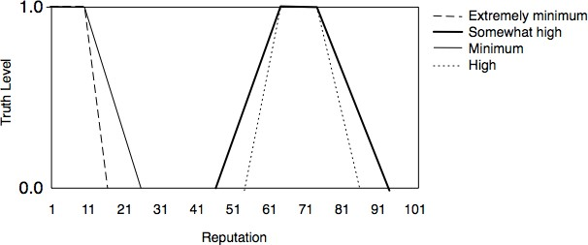
2 -­‐ Computational representation of trust and reputation values
Fuzzy sets
The reputation value is a fuzzy set over a range. The linguistic modiﬁers aﬀect the fuzzy set to express the degree of precission of the reputation value.
Example:
The reliability of reputation is implicitly represented in the shape of the fuzzy set.

Slide 9
2 -­‐ Computational representation of trust and reputation values
Trust and reputation as beliefs
In a BDI architecture, the trust and reputation values should be represented in terms of beliefs.
Using beliefs to represent trust or reputation raises two main issues:
1. To deﬁne the content and the semantics of the speciﬁc belief
Example: Take the socio-­‐cognitive theory proposed by Castelfranchi and Falcone claiming that "an agent i trusts another agent j in order to do an action α with respect to a goal φ"
Trust is about an agent and has to be relative to a given action and a given goal.
ForTrust model. Deﬁnition of a speciﬁc predicate OccTrust(i, j,α,φ) holding for speciﬁc instances of a trustor (i), a trustee ( j), an action (α) and a goal (φ). The OccTrust(i,j,α,φ) predicate is used to represent the concept of occurrent trust that refers to a trust belief holding here and now.

Slide 10
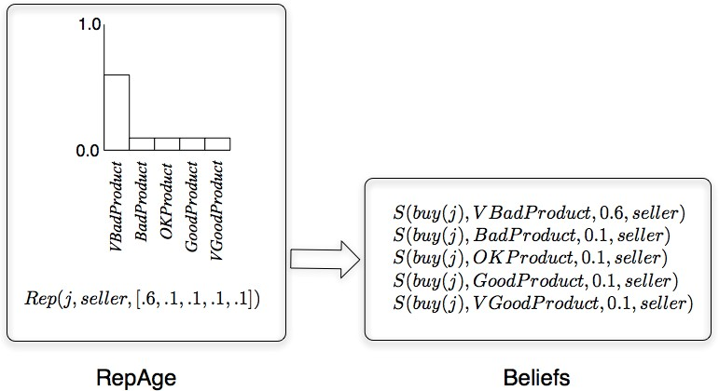
2 -­‐ Computational representation of trust and reputation values
Trust and reputation as beliefs
In a BDI architecture, the trust and reputation values should be represented in terms of beliefs.
Using beliefs to represent trust or reputation raises two main issues:
2. To link the belief to the aggregated data grounding it
Example: In BDI+RepAge the link consists in transforming each one of the probability values of the probability distribution used in RepAge into a belief.

Slide 11
2 -­‐ Computational representation of trust and reputation values
The reliability of a value
To which extend do we have to take into account a trust or reputation value in order to take a decision?
Are the foundations of that value strong enough to base a decision on it?
Some models add a measure of the reliability that the trust or or reputation value has .
Examples:
Associate a number to the trust or reputation value that reﬂects how reliable it is (ex. ReGreT).
The wideness of the fuzzy set reﬂects the reliability of the value (ex. AFRAS).

Slide 12
3 – Trust processes in multiagent systems

Slide 13
Trust evaluation or trust decision
3 – Trust processes in multiagent systems
A dual nature of trust:
Trust as an evaluation
« Trust is the subjective probability by which an individual, A, expects that another individual, B, performs a given action on which its welfare depends » [Gambetta, 88]
e.g.: I trust that my medical doctor is a good surgeon
Trust as an act
Trust is also the « decision and the act of relying on, counting on, depending on [the trustee] » [Castelfranchi & Falcone, 10]
E.g.: I decide that my medical doctor will perform a surgery on me

Slide 14
General overview of trust processes
3 – Trust processes in multiagent systems
Trust evaluation
A trustor X uses various information sources to decide if a trustee Y is trustworthy
It consists in a set of social evaluations (either images
or reputations)
Trust decision
A trustor X decides if a trustee Y can be relied on for a given task
It is a decision process taking into account trust evaluations

Slide 15
















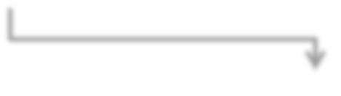
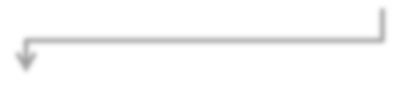



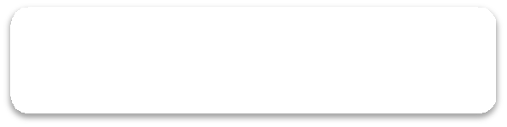



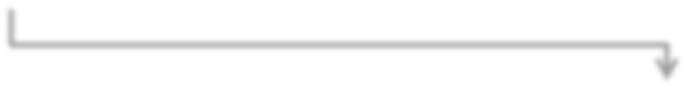
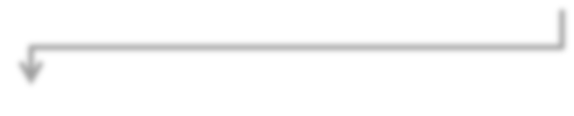



Trust processes
3 – Trust processes in multiagent systems
Social information
Direct experiences
Communicated experiences
Images
Reputations
Trust evaluations
Context
Self motivations
Trust decisions
Actions

Slide 16



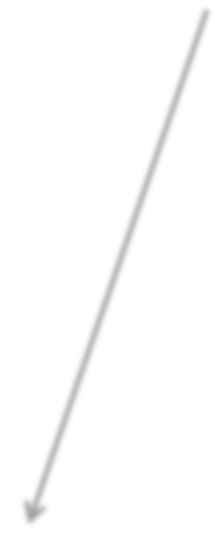










Trust evaluations (1)
3 – Trust processes in multiagent systems
Inputs coming from diﬀerent sources
Direct experiences
Direct interactions between the trustor and the trustee
Communicated experiences
Interactions between the trustee and another agent communicated to the trustor
Social information
Social relations and position of the trustee in the society
Communicated experiences
Social information
Direct experiences
Images

Slide 17
Trust evaluations (2)
3 – Trust processes in multiagent systems
Inputs need to be ﬁltered or adapted for image building to
… consider only relevant inputs for the context of an image
e.g.: if I’m building an image of a medical doctor as a surgeon, I won’t consider her past experiences as a wine recommender
… avoid using fake communicated experiences sent by
malicious agents
e.g.: if I detected that an agent sends false communicated experiences about others, I should ignore them
… adjust the communicated values if subjective trust
computation functions exist
e.g.: Alice is more severe than Bob and when she communicates a trust value of X, Bob should interpret it as X+2

Slide 18
Trust evaluation
by a statistical evaluation
3 – Trust processes in multiagent systems
Approach: Compute a single value from a set of input
One example with qualitative values [Abdul-­‐Rahman & Hailes, 00]
feedback values in the set {very good, good, bad, very bad}
aggregation function consists = keeping the most represented feedback about agent a in a context c
T(a,c,td) with td is deﬁned in
{very trustworhty, trustworthy, untrustworthy, very untrustworthy}
Another example with numerical values [Schillo et al, 00]
Trustor i had n experiences with the trustee j, in which p were positive
Aggregation function = a percentage of positive experiences
T^{i}_{j} = p/n
A third example is to keep all the experiences in a probability distribution [Sierra & Debenham, 00]

Slide 19
Trust evaluation
by logical beliefs generation
3 – Trust processes in multiagent systems
Approach: Infer a trust evaluation from a set of beliefs
Example from [Herzig et al, 10], « dispositional trust » :
def
DispTrust(Alice,Bob,write(p), written(p),Done(request(Alice,Bob,write(p)))) = PotGoal_{Alice}(written(p), request(Alice,Bob,write(p))) ∧ Bel_{Alice}G*((request(Alice,Bob,write(p)) ∧ Choice_{Alice}F written(p) -­‐>
Intends_{Bob}(write(p)) ∧ Capable_{Bob}(write(p)) ∧ AUer_{Bob:write(p)}written(p))
Informally: Alice trusts Bob to write a paper p if
she may have the goal to have a paper p wriOen and,
she believes that when she has this goal and when she asked Bob to write the paper
Bob intends to write the paper
Bob is capable of writing the paper
AQer Bob does the action write(p) the paper is wriOen

Slide 20









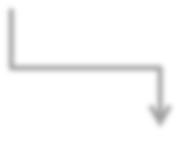
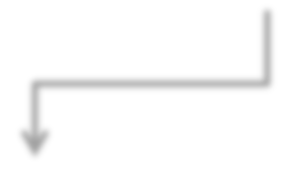



Trust decision
3 – Trust processes in multiagent systems
Trust as an act
Trust evaluations
The trust decision process takes into account
trust evaluations (images and reputations)
the context of the decision
the motivations of the trustor
The trust decision process depends on the representation formalism of trust evaluations
Self motivation
Context
Trust decisions
Actions

Slide 21









Trust value thresholds
3 – Trust processes in multiagent systems
Decision relying on thresholds
_{> Θ}trust
Trust attitude
Trust evaluation
???
Distrust attitude
_{< Θ}distrust
If Θ^{trust} ≠ Θ^{distrust}, uncertainty in the decision should be handled
The trust thresholds can be directly adjusted
with higher values if the trustor’s motivations are important or the context risky
with lower values in opposite cases

Slide 22
Trust decision as a belief
3 – Trust processes in multiagent systems
Example from [Herzig et al, 10], « occurrent trust » :
DispTrust(Alice,Bob,write(p), written(p),Done(request(Alice,Bob,write(p)))) ∧ Choice_{Alice}F written(p) ∧
Bel_{Alice}(request(Alice,Bob,write(p)))
-­‐> OccTrust(Alice,Bob,write(p), written(p))
Alice trusts here and now Bob to write a paper p in order to achieve the goal of having the paper p wriOen

Slide 23




Diversity of trust models
3 – Trust processes in multiagent systems
A current challenge is to propose solutions for T&R interoperability in 3 situations
I’m happy
Value domain
T(John, « good »)
Semantics of values
T(John, 0.6)
with John
T(John, {(0.3,0.7),
(0.4,0.25),(0.7,0.05)})
T(John, 0.6)
SharedEvaluation(John,seller) = (0.9,1)
John can do better
DirectTrust(John,seller, -0.4)
Semantics of concepts

Slide 24
4 -­‐ Reputation in multiagent societies

Slide 25
4 -­‐ Reputation in multiagent societies
"After death, a tiger leaves behind his skin, a man his reputation"
Vietnamese proverb

Slide 26
Reputation
4 -­‐ Reputation in multiagent societies
“What a social entity says about a target regarding his/her behavior”
It is always associated to a speciﬁc behaviour/property
The social evaluation linked to the reputation is not necessarily a belief of the issuer.
Reputation cannot exist without communication.
Set of individuals plus a set of social relations among these individuals or properties that identify them as a group in front of its own members and the society at large.

Slide 27
What is reputation good for?
4 -­‐ Reputation in multiagent societies
Reputation is one of the elements that allow us to build trust.
Reputation has also a social dimension. It is not only useful for the individual but also for the society as a mechanism for social order.

Slide 28
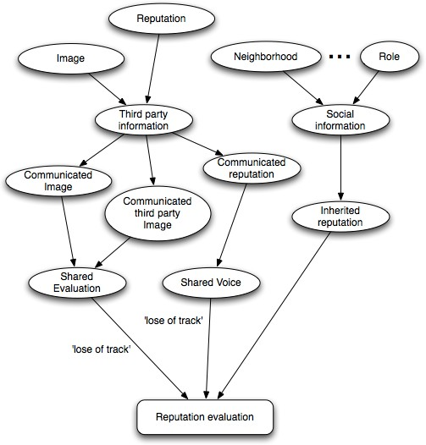
The sources for reputation
4 -­‐ Reputation in multiagent societies

Slide 29



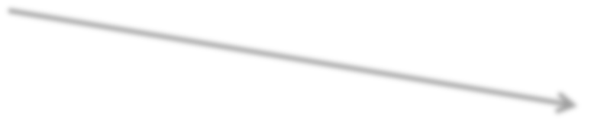


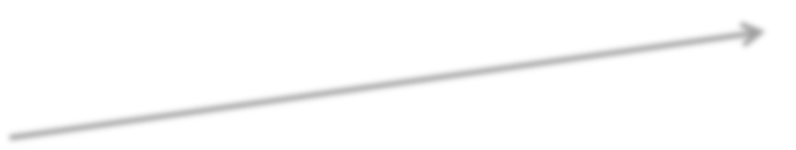


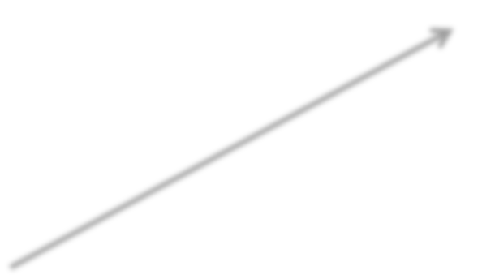


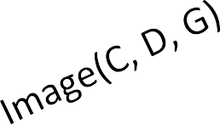


4 -­‐ Reputation in multiagent societies
Communicated Image as a source for reputation
It consists of aggregating the images that other members in the society communicate , taking this aggregation as the reputation value.
“lose of track”
Individual A
Image(A, D, G)
∑
Reputation(α, D, G)
Image(B, D, G)
Individual B
(Shared Image)
Individual C
Assumptions:
the evaluation is being communicated
the individuals that share the image are
Social entity α
a good sample of what the whole social entity thinks.

Slide 30
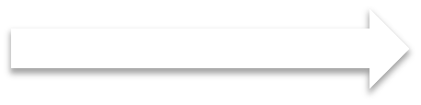



4 -­‐ Reputation in multiagent societies
Communicated reputation
It is based on the aggregation of information about reputation received from third parties.
"agent A, B and C say that the reputation of D in the social entity α is good"
"The reputation of D according to the social entity α is good"
Context dependent:
Number of communications
Shared Voice
Credibility of informers
…
Reputation evaluation
The level of individual compromise the informant is taking here is quite less than that in the communication of images.

Slide 31
4 -­‐ Reputation in multiagent societies
Inherited reputation
We call inherited reputation the reputation that
is directly inherited from third party agents with whom the subject has some kind of social relation
Example:
An employee that works for a certain company inherits the reputation of that company.
The member of a family inherits the reputation of his/her ancestors.
is associated to the role the subject is playing in the society.
Example:
The director of a research institute that has a good reputation
is supposed to have a good reputation as a researcher because of the role she/he is playing in that institution.

Slide 32








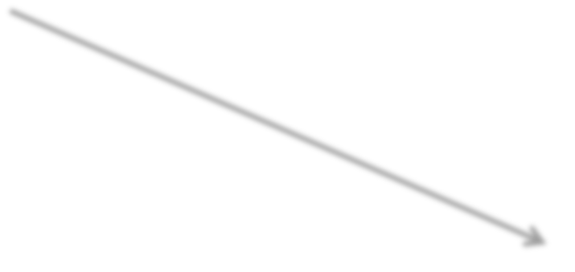
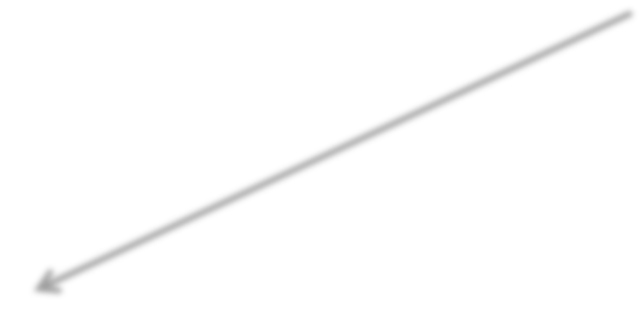




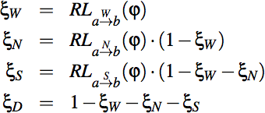
4 -­‐ Reputation in multiagent societies
Putting all together
Communicated images
Communicated reputation
Inherited reputation
Example: ReGreT
∑
R -­‐> Reputation value RL -­‐> Reliability value
W,N,S,D -­‐> witness, neighborhood, system, default reputation

Slide 33



























Centralized vs Decentralized models
4 -­‐ Reputation in multiagent societies
All the information available in the society can be used.
Centralized
Wrong or biased information has a lesser bad impact on the ﬁnal value.
First comers can beneﬁt from the information from the beginning.
Ind. A
Ind. B
The individuals have to trust the central service regarding the impartiality of the calculation.
Ind. C
Do not takes into account personal preferences and biases.
Central service
Rep. Value
The central repository is a bottleneck for the system.
Security problems.
Example:
Copyright © 1995-­‐2012 eBay Inc.

Slide 34


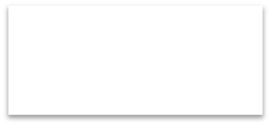





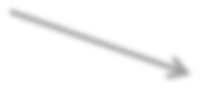






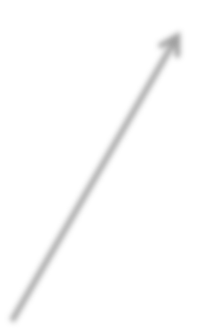


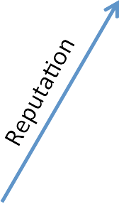





Centralized vs Decentralized models
4 -­‐ Reputation in multiagent societies
Decentralized
No trust on external central entity is necessary.
Knowledge about social relations and roles
They do not introduce any bottleneck
Ind. A
Rep. Value
Ind. B
Rep. Value
Each agent can decide the method that wants to use to calculate reputation.
It can take some time for the agent to obtain enough information to calculate a reliable reputation value. It is harder for newcomers.
It demands more complex and “intelligent” agents.
Ind. C
Rep. Value
Example: ReGreT, Travos, FIRE

Slide 35






4 -­‐ Reputation in multiagent societies
Using reputation
Reputation as a source for trust
Reputation is one of the elements that can contribute to build trust on a trustee. Usually it is used when there is a lack of direct information.
Reputation for social order
Social order -­‐> set of linked social structures, social institutions and social practices which conserve, maintain and enforce “normal” ways of relating and behaving.
Reputation incentives “socially acceptable conducts (like benevolence or altruism) and/or forbid socially unacceptable ones”.
Ostracism is the main deterrent used by reputation mechanisms.

Slide 36
4 -­‐ Reputation in multiagent societies
Pitfalls when using reputation
AOacks to reputation mechanisms
Compromise between waiting for clearer signals and acting against the aOack
Unfair Ratings
AOack: an agent sends deliberately wrong feedback about interactions with another agent.
Solution: to give more weight to the opinions of those agents that in the
past have demonstrated to be more certain.
Ballot-­‐Stuﬃng
AOack: an agent sends more feedback than interac-­‐ tions it has been partner in.
Solution: ﬁltering feedback that comes from peers suspect to be ballot-­‐ stuﬃng and using feedback per interaction rates instead of accumulation
of feedback.

Slide 37
4 -­‐ Reputation in multiagent societies
Pitfalls when using reputation
AOacks to reputation mechanisms
Dynamic Personality
AOack: an agent that achieves a high reputation attempts to deceive
other agents taking advantage of this high reputation (“value imbalance exploitation”).
Solution: to have a memory window so that not all the past history is taken into account.
Whitewashing
AOack: an agent changes its identiﬁer in order to escape previous bad feedback.
Sybil AOacks
AOack: an agent creates enough identities so it can subvert the normal functioning of the system.

Slide 38
4 -­‐ Reputation in multiagent societies
Pitfalls when using reputation
AOacks to reputation mechanisms
Collusion
AOack: this is not an attack “per se” but an enhancer of other attacks. A
group of agents co-­‐operate with one another in order to take advantage of the system and other agents
Solution: diﬃcult to detect. Detect an important and recurrent deviation in the feedbacks of diﬀerent agents regarding the same targets.
Reputation Lag Exploitation
AOack: the agent uses the lag that the reputation mechanism needs to reﬂect the new reality (usually a decrease in reputation) and exploits it to
get beneﬁt. Then it recovers the previous reputation value and starts again exploiting it.
Solution: (i) to adjust the reaction time of the reputation mechanism so it reacts quickly enough to changes in the behavior. (ii) to give the agent
the possibility to detect patterns that show a cyclic behavior in the reputation value.

